Slide 1
Confronting the Confusion Around Healthcare Bills
LMU MSBA × CEDARS-SINAI MEDICAL CENTER | 2026 CAPSTONE
1
Synthetic multi-modal data generation
2
Agentic harness engineering
3
3
Business & ROI project framing
Full-stack development
4

Slide 2
Capstone project proposal at a glance
PROBLEM
PROJECT FACTS
Hospital bills can be stressful and confusing.
SPONSOR
Cedars-Sinai Health System
LIAISON
Matthew Wells, Mgr. Advanced Analytics
Build and validate an AI system that explains every line of a patient's bill, surfaces the right resources to call, and arms the patient with talking points and questions to ask each one.
TEAM
LMU MSBA students + faculty advisor
CADENCE
Agile
WINDOW
May 18 — Aug 7, 2026 (12 weeks)
STACK CONSTRAINT
Python, Sanic, Docker (monorepo)
KEY DATES
Mar 31
May 18
Jun 12
Jul 10
Aug 7
Aug 9
Kickoff
Capstone begins
Kickoff presentation
End-to-end MVP
Final presentation
Final handoff
STUDENT LEARNING OUTCOMES (FOUR PILLARS)
Synthetic multi-modal data generation · Agentic harness engineering · Full stack development · Business & ROI project framing

Slide 3
Why this project matters
The patient's experience today
Our AI-driven opportunities
A bill arrives weeks after a hospital stay. Patients face a wall of codes, modifiers, line items, adjustments, and "patient responsibility" totals, often from multiple parties (hospital, insurer, third-party labs).
Even people who work inside healthcare organizations still occasionally struggle to read these documents. Confusion drives anxiety, late payments, calls to billing, and erodes trust in the system.
Cedars-Sinai's revenue cycle organization wants to make the financial experience as humane and supportive as the clinical one.
Decoding the bill
Plain-language explanations for every line item, code, and adjustment.
Knowing who to call
A list of resources like Cedars billing, insurer, ombudsman, financial assistance.
Knowing what to ask
Tailored talking points and questions for each resource, tied to that patient's bill.
Business impact: ↑ patient satisfaction · ↓ inbound billing call volume · ↑ trust during one of the most stressful moments of the patient journey.

Slide 4
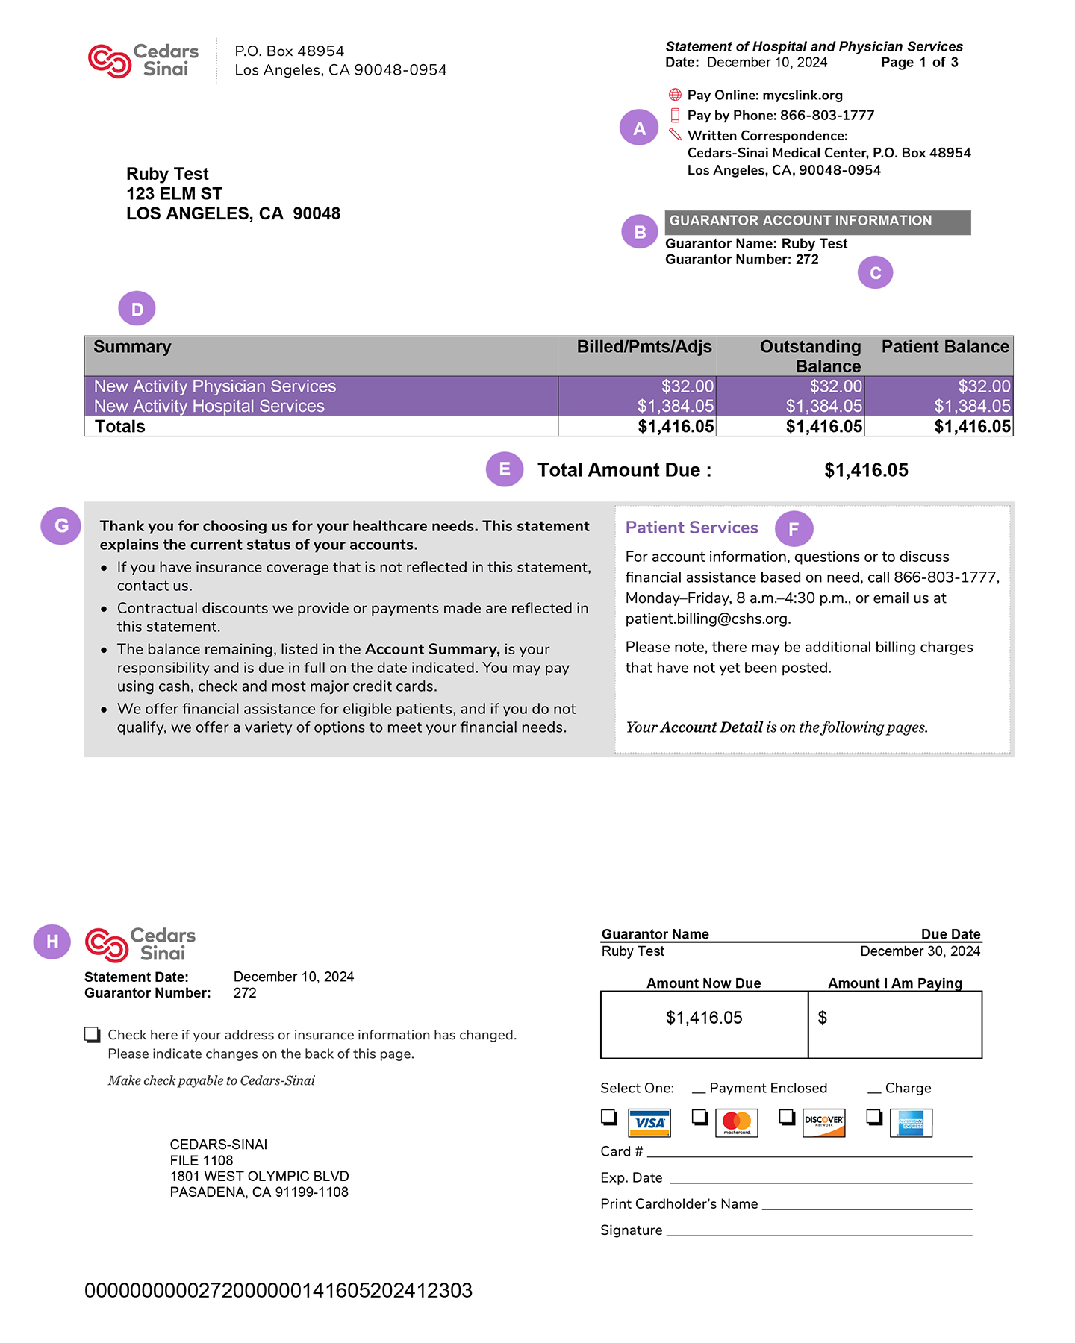
Anatomy of a real Cedars-Sinai bill
Patients generally understand D and E; the rest is where most questions come from.
A
Pay options & address
B
Guarantor section
Online, phone, and mailing details for sending payment.
Header marking the financially responsible party for this account.
C
Guarantor name & number
D
Account summary
Who’s on the hook and the account ID used in every call.
Charges grouped by physician vs. hospital services with running balance.
E
Total amount due
F
Patient services contact
Single number patients zero in on first; what they’re asked to pay now.
Phone, hours, and email to ask questions or request financial assistance.
G
Plain-language notes
H
Remittance stub
Bullets explaining insurance status, discounts, and assistance options.
Tear-off section to mail back with payment, including card-payment fields.

Slide 5
End-to-end example system architecture
INPUTS
Patient profile
Itemized bill
EOB / claim
Cedars reference set
Data
Household size, income vs. FPL, insurance status, language
Hospital + physician line items with CPT/HCPCS codes and charges
Insurer adjudication: write-offs, deductibles, denial codes
FAP policy, AGB %, FPL table, participating physicians (NPI)
REASONING
Agent orchestrator · routes the patient’s question to the right specialist tools and reasons over their results.
Agentic harness
Bill parser
Code translator
Coverage reasoner
FAP eligibility
Action planner
Extract line items from PDF bill
CPT/HCPCS to plain English
Why the insurer paid (or didn’t)
FPL %, family size, insurance status
Next steps + scripts
DELIVERY
Web app
Explanation view
Resources panel
Action scripts
Patient-facing frontend
Patient-facing UI for upload, chat, and review
Annotated bill in plain language with dollar breakdowns
FAP path, payment plans, Medi-Cal screening, dispute options
Phone, email, and form drafts patients can copy and send

Slide 6
Learning expectations
We evaluate each pillar is an in-demand skill for AI engineers, data scientists, and analysts.
PILLAR 01
PILLAR 02
PILLAR 03
PILLAR 04
Synthetic multi-modal data generation
Agentic harness engineering
Full-stack
development
Business & ROI framing
Engineer datasets to train, prompt, and evaluate against, without touching real PHI.
Build the orchestration that turns a frontier LLM into a reliable, tool-using analyst over a patient's bill.
Ship a usable patient-facing app that the Cedars-Sinai team can demo and hand to engineering for integration.
Frame the work as a business case so Cedars-Sinai leadership can fund the next phase.
OUTCOME
OUTCOME
OUTCOME
OUTCOME
Dataset design from a problem
Prompt-engineered generation
Multi-modal scaffolding
Provenance & gold labels
Tool-use & function calling
Planner / sub-agent design
Memory & retrieval
Failure-mode telemetry
Guided AI workflow UI
Streaming & state management
Auth, env vars, secrets
Containerized deploy & CI/CD
ROI sizing & cost-benefit analysis
Stakeholder narrative & framing
Defining success metrics
Roadmap to productionization

Slide 7
Example 12-week project roadmap
May 18
Jun 1
Jun 15
Jun 29
Jul 13
Jul 27
W1
W2
W3
W4
W5
W6
W7
W8
W9
W10
W11
W12
Sprint 1 · Discovery & data design
Sprint 2 · Synthetic data MVP
Sprint 3 · Agent harness v1
Sprint 4 · MVP + integration
Sprint 5 · Eval harness & iteration
Sprint 6 · Hardening & handoff
Sprint 1 starts
Kickoff · Jun 12
E2E MVP · Jul 10
Final · Aug 7
MILESTONES
Foundation sprints
Build sprints

Slide 8
Evaluation example framework
Students decide which metrics to instrument and how to measure them.
01 / SYNTHETIC DATA
02 / AGENTIC SYSTEM
03 / PERFORMANCE & COST
04 / PRODUCT & UX
Dataset quality
Pipeline behavior
Run economics
Patient experience
Fidelity
Task success
Latency
Time-to-answer
How closely the data resembles what students would see in production.
How often the agent gets the whole task right on a held-out set.
How fast the system feels at the points users wait.
How quickly a patient gets to something useful on screen.
Diversity
Tool correctness
Token spend
Comprehension
How well the dataset spans the patient and payer cases that matter.
Whether tool calls are well-chosen, well-formed, and well-sequenced.
What a typical interaction costs to run, and where the spend goes.
Whether a non-expert can restate the bill in their own words.
Privacy
Groundedness
Throughput
Next-step clarity
How students can show no real PHI is recoverable from the set.
How tightly each claim is anchored to a real source document.
How many concurrent users the stack can serve before it strains.
Whether the patient leaves knowing what to do next.
Utility
Recovery
Reliability
Trust
Whether models built or prompted on it actually work downstream.
What happens when a step fails, and how gracefully it recovers.
How often a session completes cleanly without errors or timeouts.
How confident the patient feels in acting on what they saw.

Slide 9
Risk, ethics & example responsible-AI guardrails
01
Synthetic data
02
Honesty about uncertainty
Students work exclusively with synthetic patients, bills, and EOBs.
No PHI is ever exported, accessed, or required for any pillar.
Datasets are generated in-program from problem statements.
Cedars team validates realism without compromising privacy.
Cite-or-refuse prompting: every claim ties to a source line.
Deterministic facts (codes, math, totals) handled by tools, not the LLM.
Adversarial probes in the eval suite stress-test hallucination.
Confidence is surfaced in the UI; "unknown" is a valid answer.
03
Scope & UX
04
Bias & fairness
Persistent banner: this is an AI assistant, not medical or legal advice.
No promises about coverage, billing outcomes, or clinical guidance.
Plain-language target capped at a 6th-grade reading level.
English is one option in the UI, not the assumed default.
Synthetic personas span a deliberate range of demographics and conditions.
Eval suite checks answer quality across persona segments, not just averages.
Plain-language and reading-level targets reduce health-literacy bias.
Students document who the system serves well and where it falls short.

Slide 10
Final deliverables checklist
DELIVERABLE
DATE
DESCRIPTION
AUDIENCE
Kickoff Presentation
Jun 12
Problem statement, scope, plan, v1 demo.
Both
Final Presentation
Aug 7
Methodology, results, limitations, extensions.
Both
Final Report
Aug 9
Written companion to the final presentation; Cedars-ready.
Both
Codebase
Aug 9
Monorepo: data generators, agent harness, frontend, eval suite.
Cedars
Synthetic dataset
Aug 9
Versioned bundles (patients, bills, EOBs, resources, gold labels).
Cedars
Eval harness + dashboard
Aug 9
Reproducible nightly run + metrics history.
Cedars
Hosted demo URL
Aug 7
Live patient-facing app for stakeholder walkthroughs.
Cedars
Runbook & architecture doc
Aug 9
How to run, deploy, debug, extend.
Cedars
Demo video (5 min)
Aug 9
End-to-end walkthrough of one resolution.
Cedars

Slide 11
Stretch goals & next-year extensions
Within reach if a sprint gets ahead, or a runway for future teams.
Voice interface
NOW
Multilingual delivery
NOW
Patients speak the bill out loud (or upload a photo); agent narrates back. Big accessibility win.
Spanish first (Cedars's largest non-English population); pluggable for more.
Photo / OCR ingestion
NEAR
Dispute-letter generator
NEAR
Phone-camera capture of a bill PDF. Adds OCR pipeline + image-quality handling.
When a denial is detected, draft an appeal letter the patient can send.
EHR / billing-system integration
NEXT YEAR
Cohort analytics for Cedars
NEXT YEAR
Replace synthetic ingestion with a real (HIPAA-compliant) read-only feed from Cedars systems.
Aggregate (anonymized) patient confusion patterns into a feedback signal for billing operations.

